Slide 1
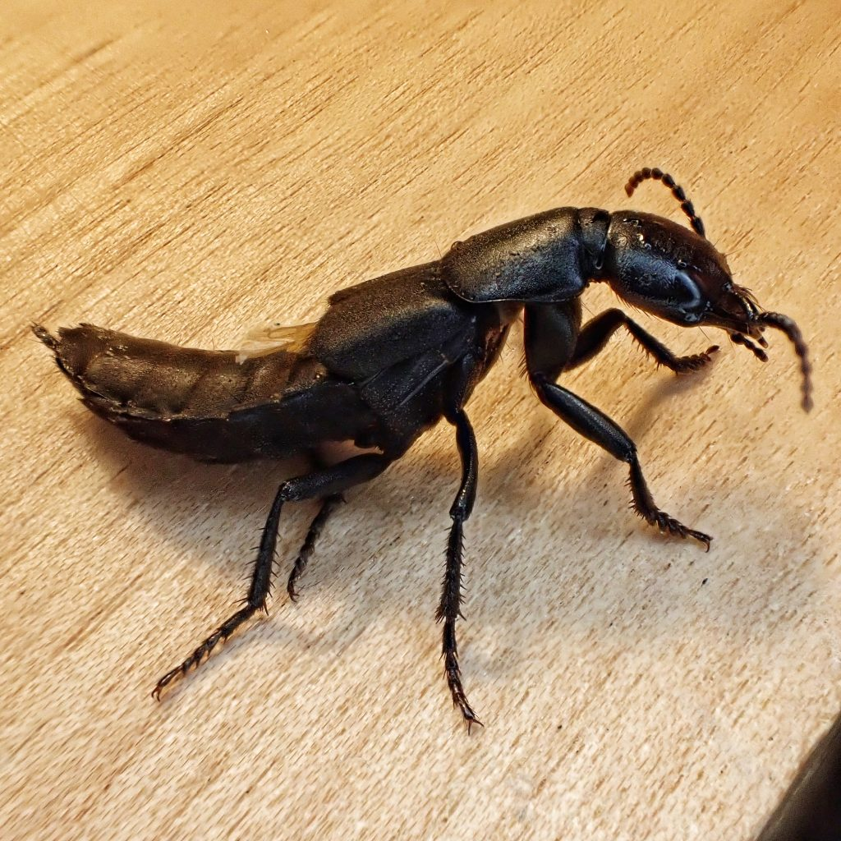
Roberta Hunt, José L. Reyes-Hernández, Josh Jenkins Shaw, Alexey Solodovnikov, Kim Steenstrup Pedersen. 2025. “Integrating Deep Learning Derived Morphological Traits and Molecular Data for Total-Evidence Phylogenetics.” Systematic Biology 74(3): 453-468
https://doi.org/10.1093/sysbio/syae072
Note elytra
Folded wings!
Class focus area: Machine learning for traits
EEB603: Brian O’Meara
Photo by Dan Nelson, http://10000thingsofthepnw.com/2021/12/20/ocypus-olens-devils-coach-horse/
All quotes and images from the above paper unless otherwise noted

Slide 2
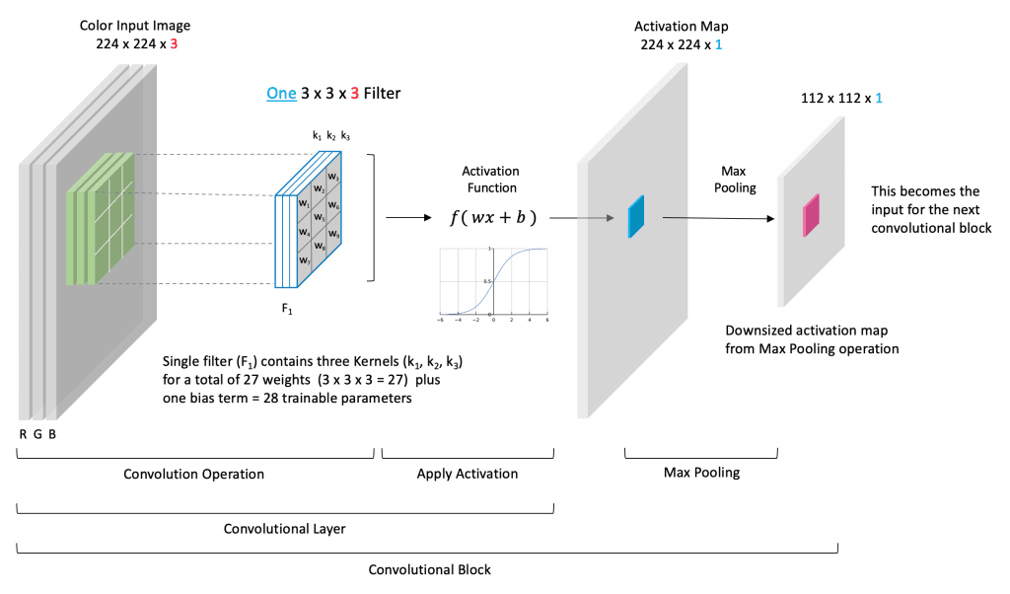
From (and a really good explanation at): https://learnopencv.com/understanding-convolutional-neural-networks-cnn/

Slide 3
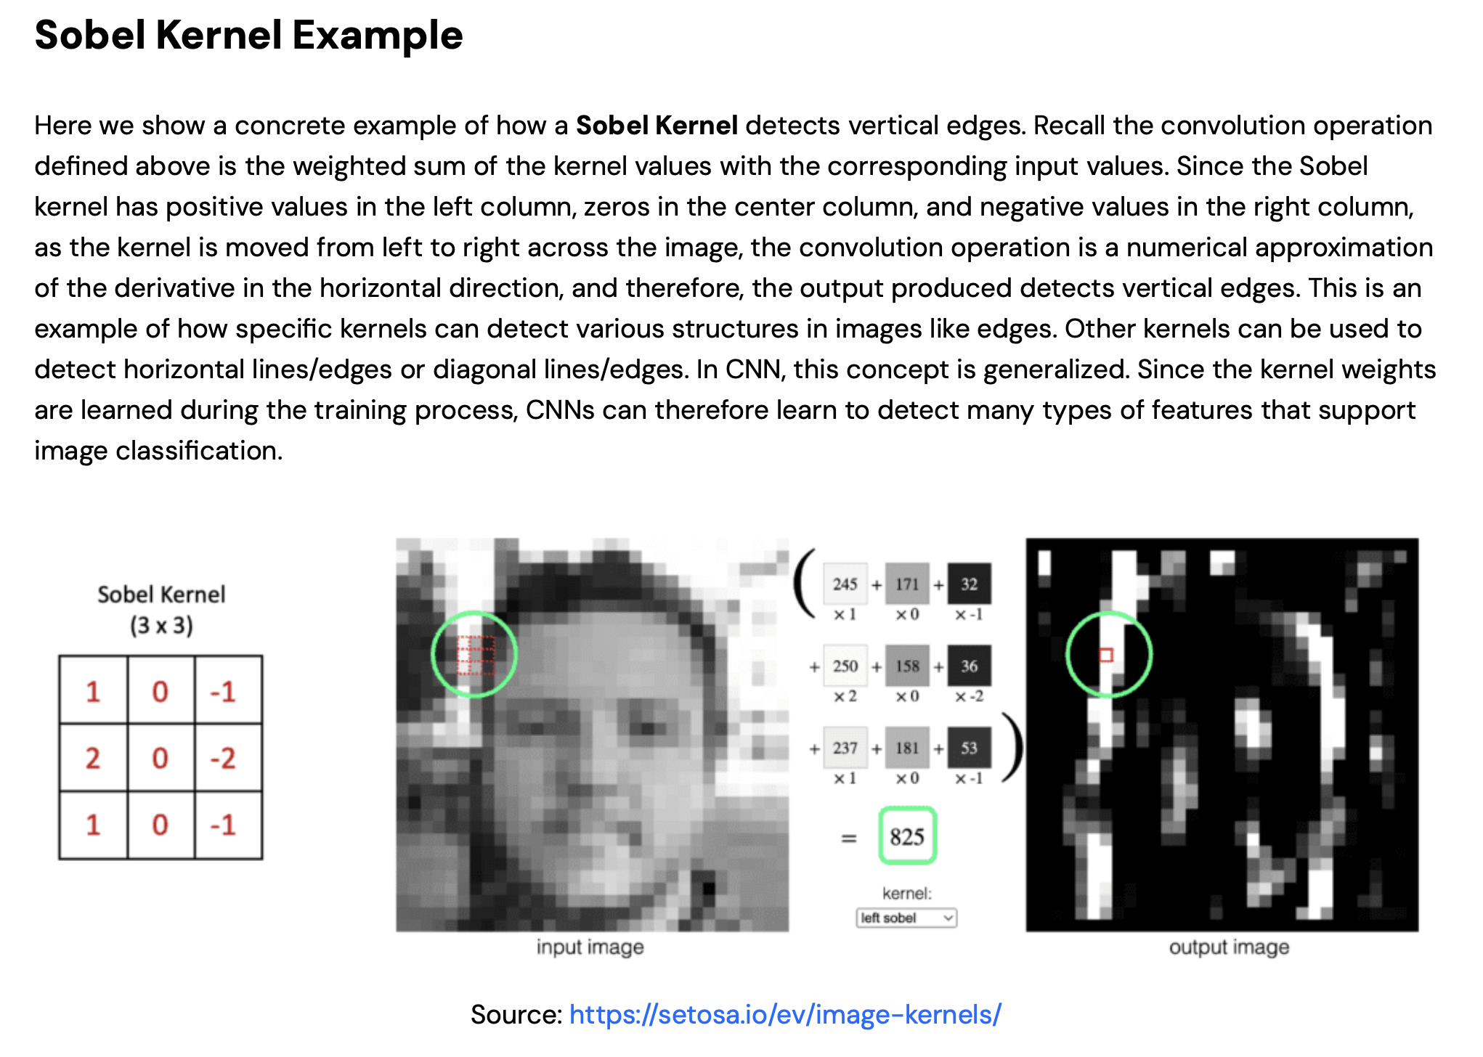
From (and a really good explanation at): https://learnopencv.com/understanding-convolutional-neural-networks-cnn/

Slide 4
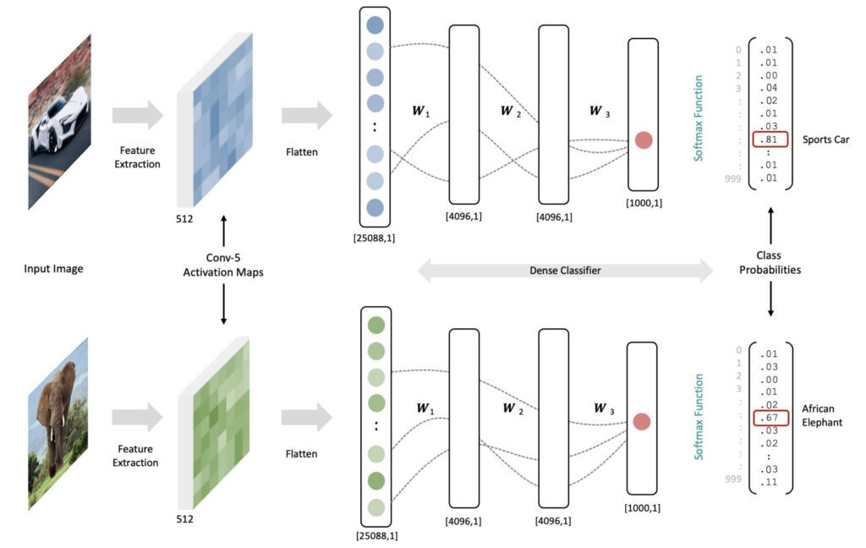
From (and a really good explanation at): https://learnopencv.com/understanding-convolutional-neural-networks-cnn/

Slide 5
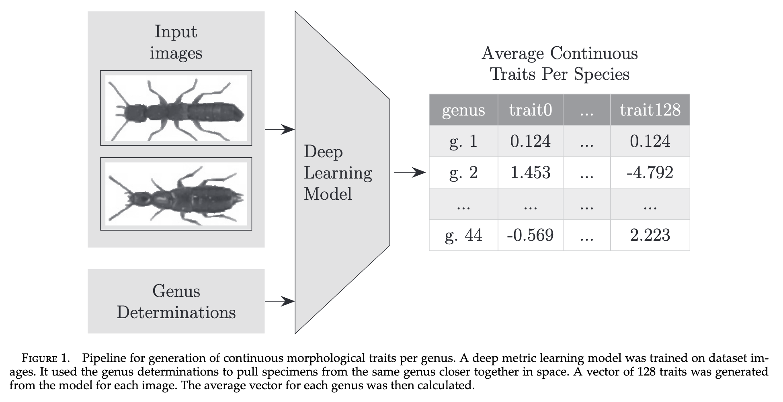

Slide 6
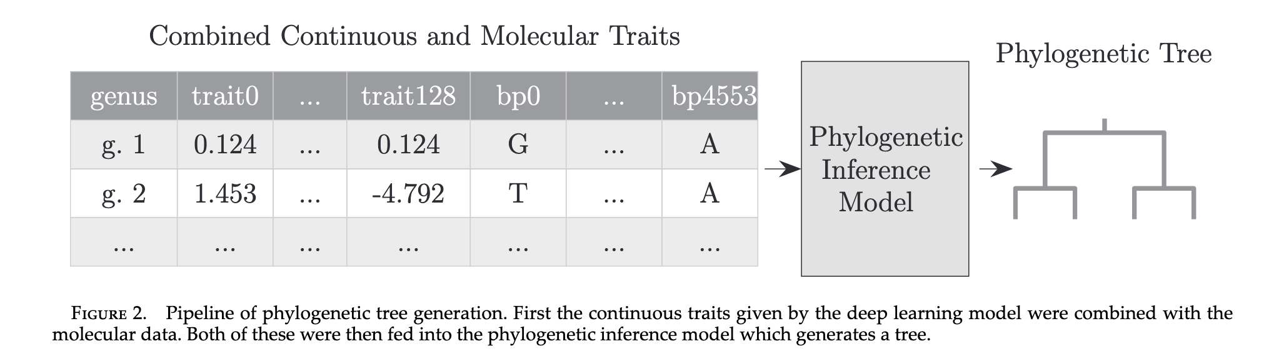

Slide 7
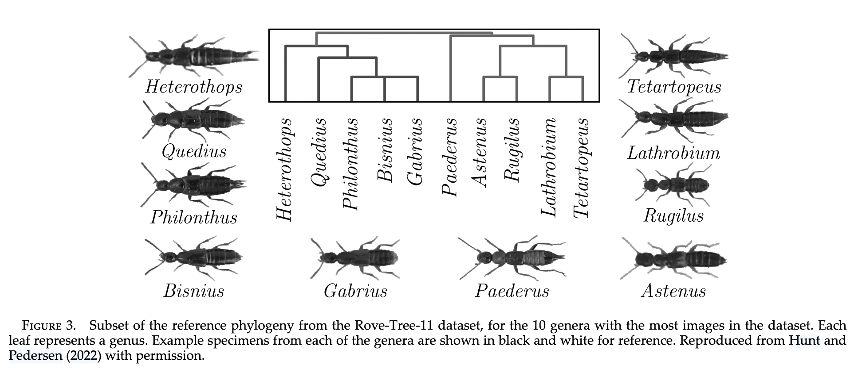

Slide 8
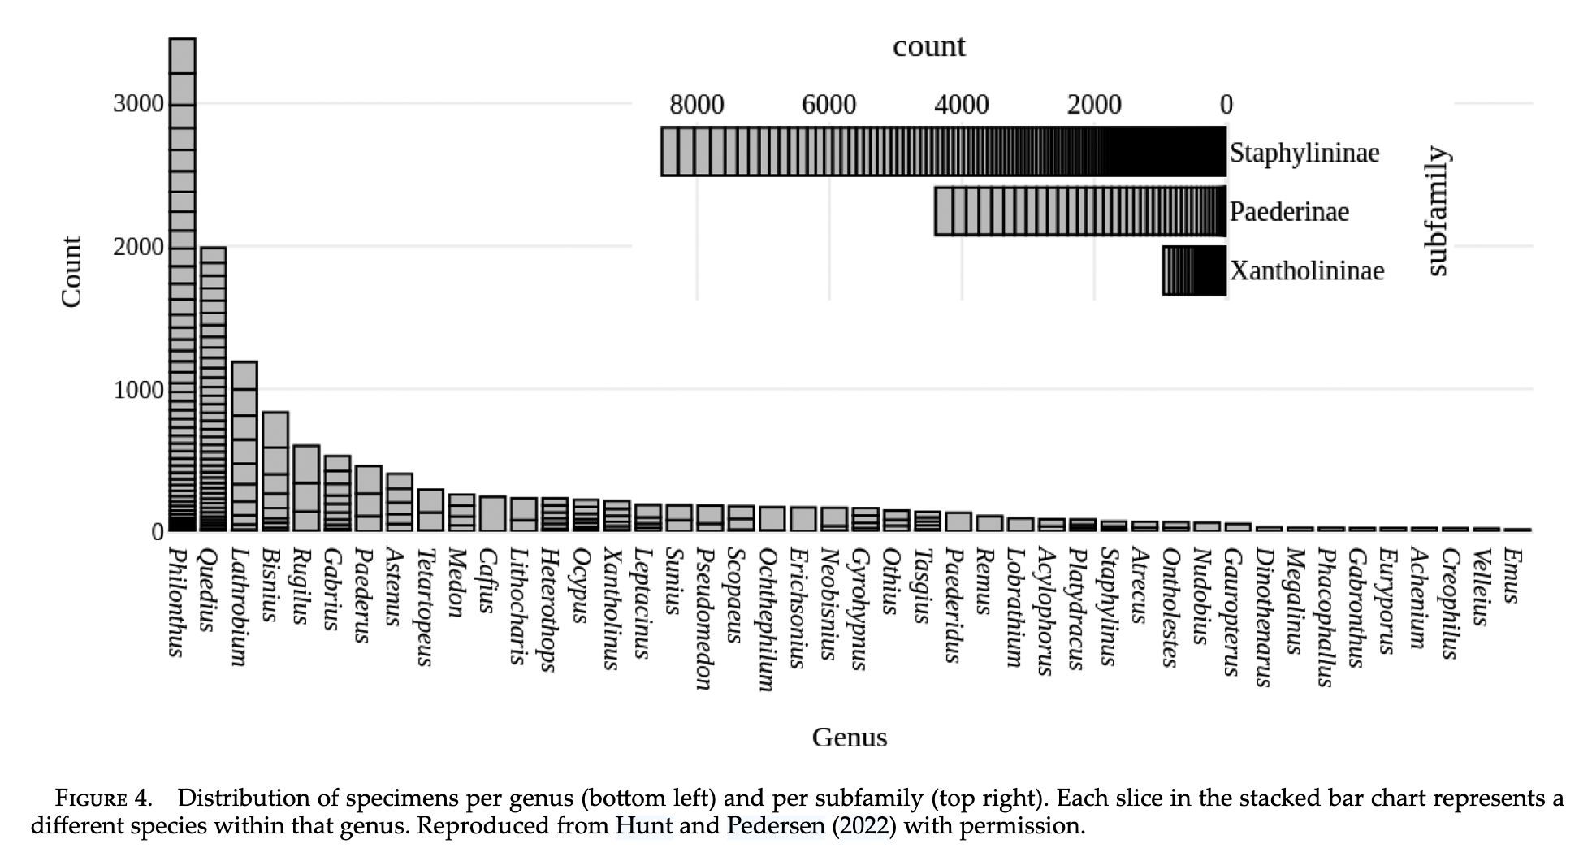

Slide 9
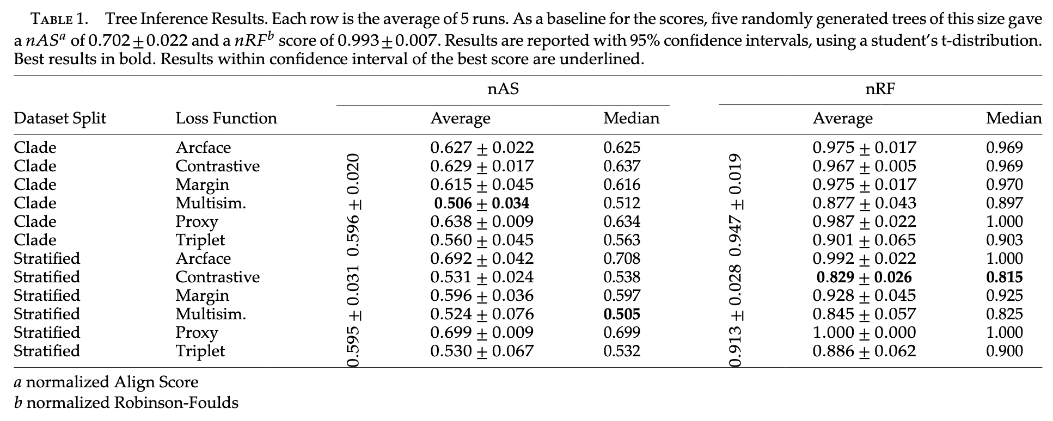

Slide 10
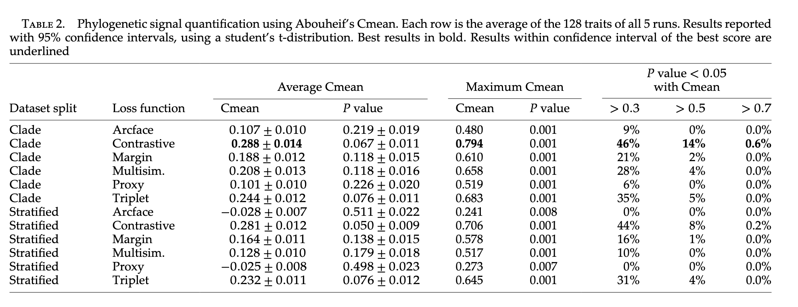

Slide 11
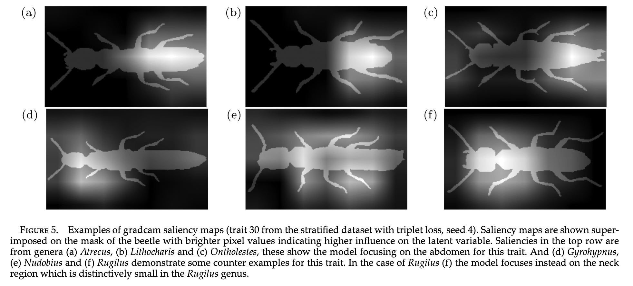

Slide 12
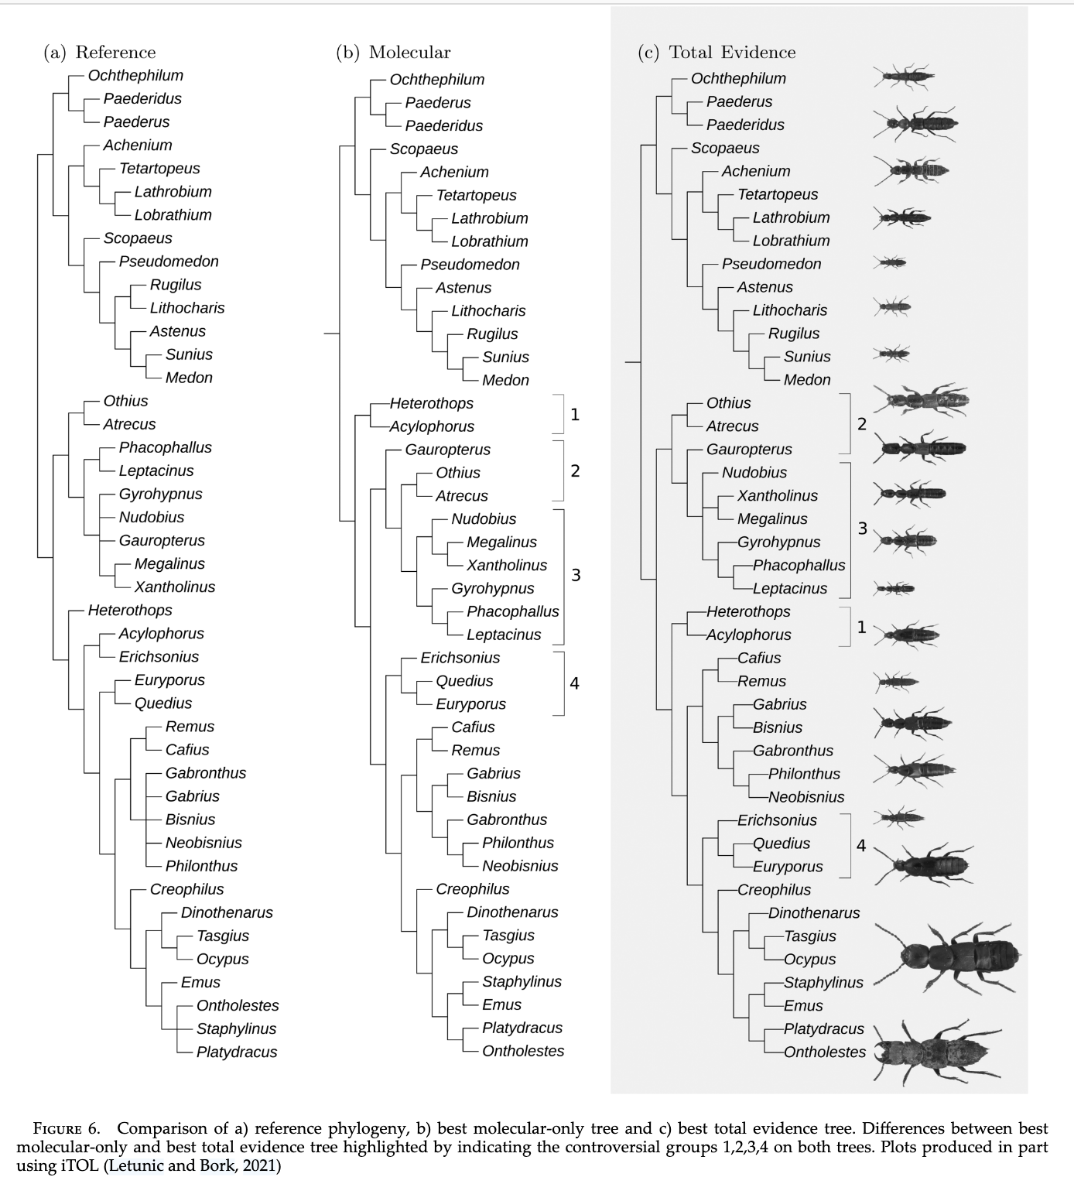

Slide 13
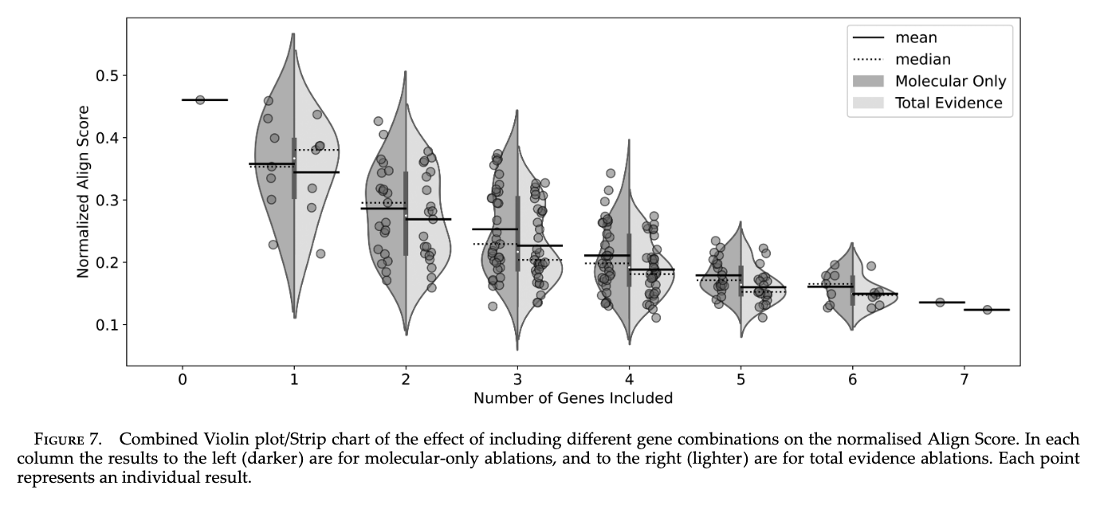

Slide 14
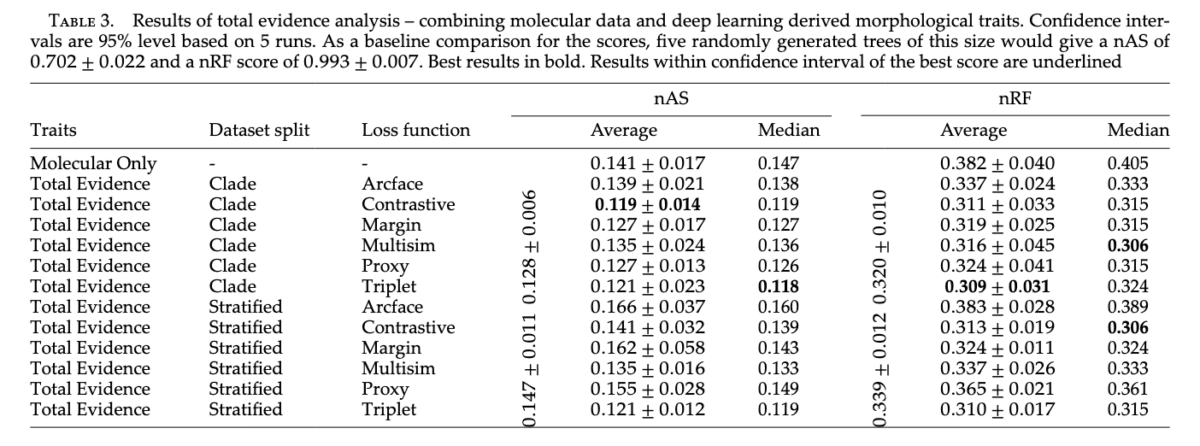

Slide 15
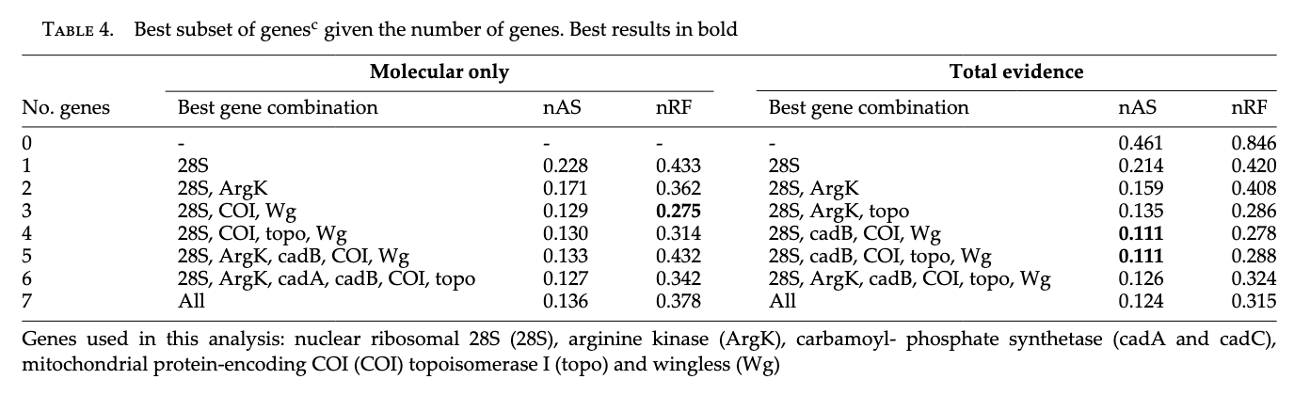

Slide 16
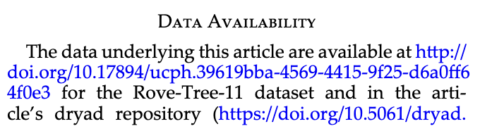
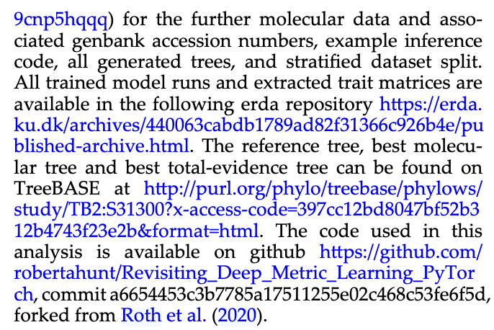

Slide 17
Quantitative morphological characteristics, extracted through the application of deep learning techniques applied to images of pinned insect specimens produced for mass collections digitization purposes, have been demonstrated to possess phylogenetic relevance. These traits, when integrated into molecular phylogenies, have the potential to augment the phylogenetic framework in a comprehensive total‐evidence based approach, offering the possibility of incorporating species lacking molecular data into phylogenetic trees. However, the improvement of phylogenetic reconstructions by the inclusion of such morphological data derived through deep learning methodologies remains minimal. While this approach has shown promise, scaling up its implementation is still not feasible for 2 reasons. First, the phylogenetic signal of the deep learning derived traits, at least in our dataset, was not strong enough to justify the additional effort in gathering the data. Second, the effort required for our image‐based model testing, even though likely lesser than an effort by the expert to assemble a traditional morphological phylogenetic matrix, is still significant.

Slide 18
“Homology”
“Habitus”
Cmeans vs Pagel lambda?
Loss functions
Other traits, like calls?
How long would it take a skilled taxonomist in this field to take all the measurements and make a tree that way?
Some say if you build a tree from morphological characters, you can't use that tree to test the evolution of those characters (because it would be circular). Is that true?
Is it possible to incorporate continuous trait information in a maximum likelihood framework?
How realistic are these morphotyping approaches for species with high plasticity?
How do we scale deep-learning-based morphotyping to megaflora/megafauna that outscale standard imaging/camera resolutions?
What are the assumptions of total evidence approach or what total evidence approach means?
Wouldn't it be essential to have a taxonomist or group expert curating the data, such as collection names that will later be used by the deep learning, and also reviewing the iNaturalist names before using them for these analyses? or is not so relevant?
Does this show more evidence of need to digitize collections?

